Slide 1
Logistic Regression
Dr. Asma Ahmad
https://machinelearningmastery.com/logistic-regression-for-machine-learning/

Slide 2

Classification
Email: Spam / Not Spam?
Online Transactions: Fraudulent (Yes / No)?
Tumor: Malignant / Benign ?
0: “Negative Class” (e.g., benign tumor)
1: “Positive Class” (e.g., malignant tumor)

Slide 3

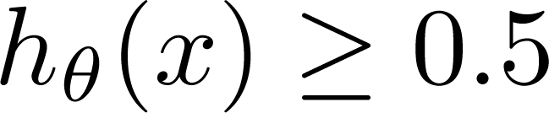
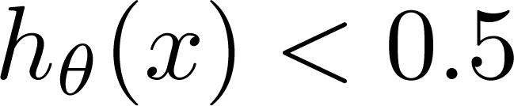
(Yes) 1
Malignant ?
(No) 0
Tumor Size
Tumor Size
Threshold classifier output at 0.5:
If , predict “y = 1”
If , predict “y = 0”

Slide 4

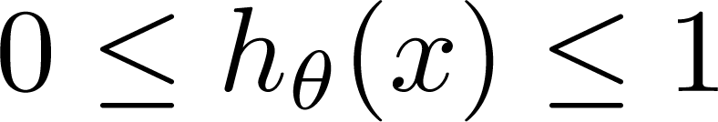
Classification: y = 0 or 1
can be > 1 or < 0
Logistic Regression:

Slide 5
Introduction
Another technique borrowed by machine learning from the field of statistics.
Go-to method for binary classification problems (problems with two class values)

Slide 6
Logistic Function
Logistic regression is named for the function used at the core of the method, the logistic function.
Also called the sigmoid function
It’s an S-shaped curve that can take any real-valued number and map it into a value between 0 and 1
1 / (1 + e^-value)
Where e is the base of the natural logarithms (EXP() function)
Value is the actual numerical value that you want to transform.

Slide 7
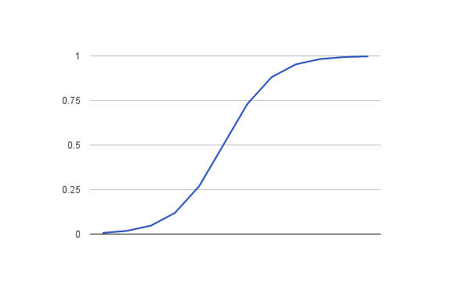
Logistic Function

Slide 8
Representation Used for Logistic Regression
Logistic regression uses an equation very much like linear regression.
Input values (x) are combined linearly using weights or coefficient values (referred to as the Greek capital letter Beta) to predict an output value (y).
A key difference from linear regression is that the output value being modeled is a binary values (0 or 1) rather than a numeric value.

Slide 9
Cont.
Below is an example logistic regression equation:
y = e^(b0 + b1*x) / (1 + e^(b0 + b1*x))
Where y is the predicted output
b0 is the bias or intercept term and b1 is the coefficient for the single input value (x).
Each column in your input data has an associated b coefficient (a constant real value) that must be learned from your training data.
The actual representation of the model that you would store in memory or in a file are the coefficients in the equation (the beta value or b’s).

Slide 10
Making Predictions with Logistic Regression
y = e^(b0 + b1*X) / (1 + e^(b0 + b1*X))
y = exp(-100 + 0.6*150) / (1 + EXP(-100 + 0.6*X))
y = 0.0000453978687
Notes:
We have learned the coefficients of b0 = -100 and b1 = 0.6. Using the equation above we can calculate the probability of male given a height of 150cm or more formally P(male|height=150). We will use EXP() for e, because that is what you can use if you type this example into your spreadsheet:
y = e^(b0 + b1*X) / (1 + e^(b0 + b1*X))
y = exp(-100 + 0.6*150) / (1 + EXP(-100 + 0.6*X))
y = 0.0000453978687
Or a probability of near zero that the person is a male.
In practice we can use the probabilities directly. Because this is classification and we want a crisp answer, we can snap the probabilities to a binary class value, for example:
0 if p(male) < 0.5
1 if p(male) >= 0.5

Slide 11
Multi-class Classification One-vs-All
Logistic Regression

Slide 12
Multiclass classification
Email foldering/tagging: Work, Friends, Family, Hobby
Medical diagrams: Not ill, Cold, Flu
Weather: Sunny, Cloudy, Rain, Snow

Slide 13
Binary classification:
Multi-class classification:
x₂
x₂
x₁
x₁

Slide 14

One-vs-all (one-vs-rest):
x₂
x₁
x₂
x₂
x₁
x₁
Class 1:
Class 2:
Class 3:
x₂
x₁

Slide 15
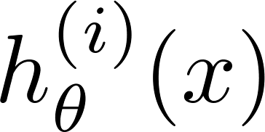

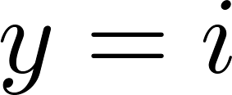

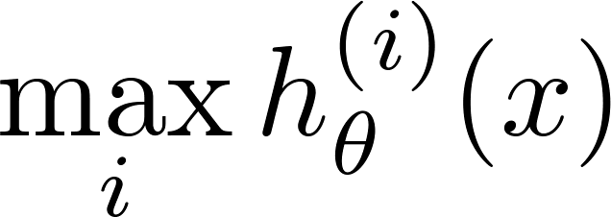
One-vs-all
Train a logistic regression classifier for each class to predict the probability that .
On a new input , to make a prediction, pick the class that maximizes

